Slide 1
Codepth Hackathon
Data Analysis and ML Modelling
Submitted By-
Name : Rahul Bordoloi
Ph No : 9864887529
Website : https://rahulbordoloi.me

Slide 2
Problem Statement
To Perform Data Analysis on the given dataset and form an insightful report on it.
To Devise a ML Algorithm which will help to predict the employees of company who would be leaving and control it acccordingly.

Slide 3
Technical Goal
To find an optimal solution of a Classification Model.
The goal is to find an optimal team of independent variables so that each independent variable of the team has great impact on the dependent variable profits that each independent variable of the team is a powerful predictor that is highly statistically significant.
Perform EDA on the datasets given and take out the insightful analysis for Research.

Slide 4
Assumptions
We make the assumption that the company had given the total database of the employees before attrition.

Slide 5
About the Datasets
Before Attrition, There were a total of 14,999‬ Employees working for the company.
And after the Attrition, 3571 employees left the company leaving behind 11428 employees.
Extension of File Format was .xls

Slide 6
Meeting the Objectives
What type of employees are leaving? Why are they leaving? Determine which employees are prone to leave next.
>> According to Detailed Analysis Report, Employees are are working Overtime a Lot, and also have a very less Job Satisfaction are more prone to leave the Company at earliest. Also, there's a pattern followed where employees with less time spent with the company tend to leave the comapany earlier.
Also, Employees who are paid less are observed to be a major factor in attrition.
Extra Insights : Employees from HR tend to leave more, so maybe work atmosphere or leadership issue might be a problem in this case.

Slide 7
The analysis description should not be history, it should be to the point with little description of how to proceed. You need to make a ppt on what algorithms you have used, and what was your motive behind using those.
>> A Total of 12 Algorithms are being used here. The Problem Statement given here is a case of Classification Problem as we've to predict an employee that would be leaving the company or not. (Binary Classification). The Different Algorithms being used are -
Classic ML Algorithms : Logistic Regression, Kernel & Linear SVM, K-NN, Naive Bayes
Tree Based : Decision Tree.
Ensembled Based : Random Forest
Boosting Algorithms : XGBoost Classifier, GradientBoosting Classifier, AdaBoost Classifier, CatBoost Classifier, LightGBM.

Slide 8
The above Classification Algorithms were been implemented and the model with best performance was worked on (hyperparameter tuning) for further model performance.
Out of all the Algorithms, Random Forest was being selected as being the model with best Performance. It's a Tree Based Ensemble Learning Algorithm which helps us to build a powerful model from the collective perfomances of n-classifing decision sticks improving its perfomance drastically.

Slide 9
Technical Report and Insights from the Datasets

Slide 10
1. Analysis for Existing Employees.
There are 11428 employees currently working for the company
There are no null entries in existing employee dataset.
Also, there are No Duplicate Columns.
There are No Constant Columns.
'Work_accident' and 'promotion_last_5years' are Binary Categorical Features.
There are a total of 10 Departments under the Company.
There are only 3 Categories for Salaries that are to be paid to 10 Departments.

Slide 11
The Three categories of Salaries are - 'low' 'medium' 'high'.
The Employees have worked for different number of years with the years being [ 3 2 4 6 5 8 10 7] respectively.
The Employees have usually worked on different projects with the numbers being [4 2 5 3 6] respectively.
The Feature 'promotion_last_5years' is highly imbalanced.
% of People Having 'Low' Salary : 45.01225061253062 %
% of People Having 'Medium' Salary : 44.88099404970248 %
% of People Having 'High' Salary : 10.106755337766888 %
There are less Highly Paid Employees as compared to Low and Medium wage slab employees.

Slide 12
No of Employees in the Department of sales are : 3126
No of Employees in the Department of accounting are : 563
No of Employees in the Department of hr are : 524
No of Employees in the Department of technical are : 2023
No of Employees in the Department of support are : 1674
No of Employees in the Department of management are : 539
No of Employees in the Department of IT are : 954
No of Employees in the Department of product_mng are : 704
No of Employees in the Department of RandD are : 666
No of Employees in the Department of marketing are : 655

Slide 13
Out of all the Departments, Sales has the most number of Employees being 3126 and the Least Number of Employees are in the Department of HR being 524 respectively.
RandD is the Highest Paid Department followed by Support.
Management is the Least Paid Department.
Salary Amount has no impact on Promotion.

Slide 14
2. Analysis for Employees who Left.
There are 3571 employees who left the company
There are no null entries in existing employee dataset.
Also, there are No Duplicate Columns.
There are No Constant Columns.

Slide 15
The Employees have worked for different number of years with the years being [3 6 4 5 2] respectively.
On a Comparative Note :
Employees who have left the job tend to spend more time working as compared to the existing Employees.
The Maximum time spent by an Employee individually is more in case of existing than the ones who left.
The Employees have usually worked on different projects with the numbers being [2 5 7 6 4 3] respectively.
On a Comparative Note :
Employees who have left the job tend to have less number of projects as compared to the existing Employees.
The Maximum number of project performed by an Employee individually is more in case of left than the one who are existing.

Slide 16
The Feature 'promotion_last_5years' is highly imbalanced Feature and a Quasi-Constant Feature.
% of People who had 'Low' Salary : 60.82329879585551 %
% of People who had 'Medium' Salary : 36.88042565107813 %
% of People who had 'High' Salary : 2.2962755530663683 %
The % of people leaving the company were the ones with low salaries.

Slide 17
No of Employees were in the Department of sales are : 1014
No of Employees were in the Department of accounting are : 204
No of Employees were in the Department of hr are : 215
No of Employees were in the Department of technical are : 697
No of Employees were in the Department of support are : 555
No of Employees were in the Department of management are : 91
No of Employees were in the Department of IT are : 273
No of Employees were in the Department of product_mng are : 198
No of Employees were in the Department of marketing are : 203
No of Employees were in the Department of RandD are : 121

Slide 18
Out of all the Departments, Maximum People left the company from the Department of Sales being 1014 followed by Technical.
Department of Management has the least number of attrition being 91 followed by RandD.
Out of all the Departments, Maximum People left the company from the Department of Sales being 1014 followed by Technical.
Department of Management has the least number of attrition being 91 followed by RandD.

Slide 19
3. Analysis on the merged Dataset
% of 'Low' Salaried Employees that Left : 29.68835429196282 %
% of 'Medium' Salaried Employees that Left : 20.431275209432208 %
% of 'High' Salaried Employees that Left : 6.628940986257073 %

Slide 20
% of sales Employees that Left : 24.492753623188406 %
% of accounting Employees that Left : 26.597131681877446 %
% of hr Employees that Left : 29.093369418132614 %
% of technical Employees that Left : 25.624999999999996 %
% of support Employees that Left : 24.89905787348587 %
% of management Employees that Left : 14.444444444444443 %
% of IT Employees that Left : 22.249388753056234 %
% of product_mng Employees that Left : 21.951219512195124 %
% of RandD Employees that Left : 25.794155019059723 %
% of marketing Employees that Left : 14.102564102564102 %

Slide 21
Through % of employees leaving the company from their respective departments are almost same, but % is highest in case of HR which is 29% and lowest in the case of Marketing ie 14%.
There is no such trend of Attrition in case of Work Accidents.
People who have spent less time with the company tends to leave it earlier as compared to the ones who are here for a longer period of time.
There's no such specific pattern as such, but the employees working highly overtime tend to leave the company.
Same is the case for Satifaction Level, employees less satified with their job end to leave their job earlier.

Slide 22
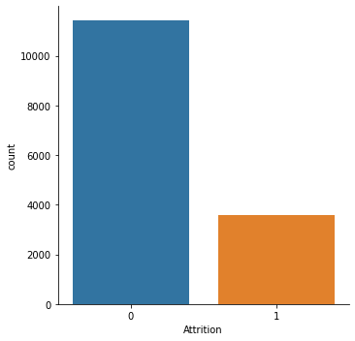
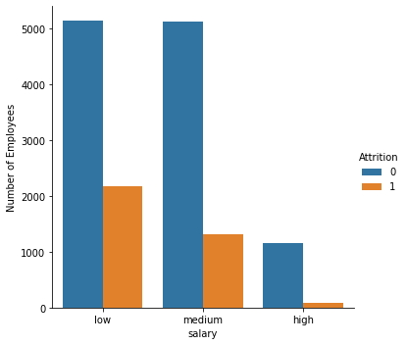
So, Salary is definitely a major factor in attrition.

Slide 23
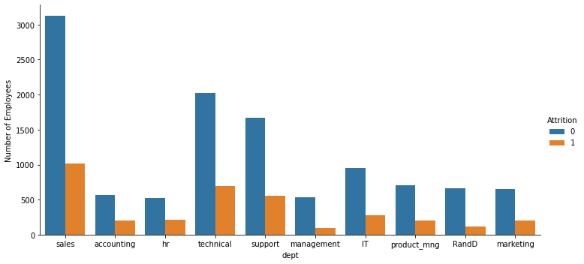
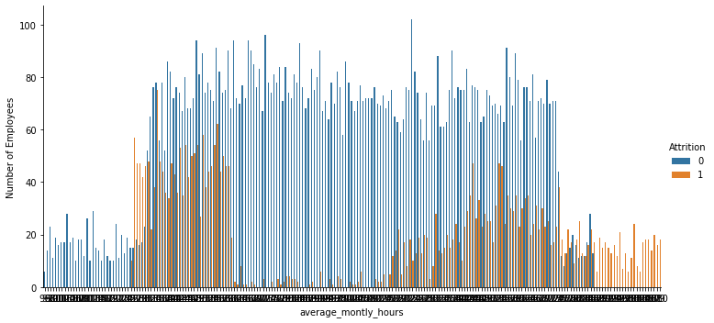

Slide 24
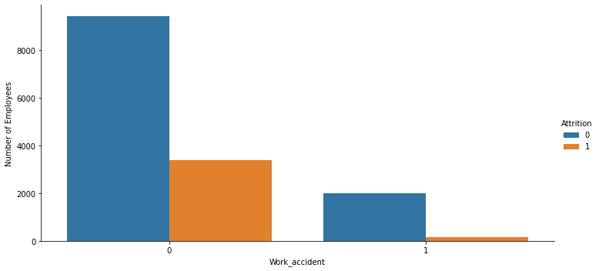
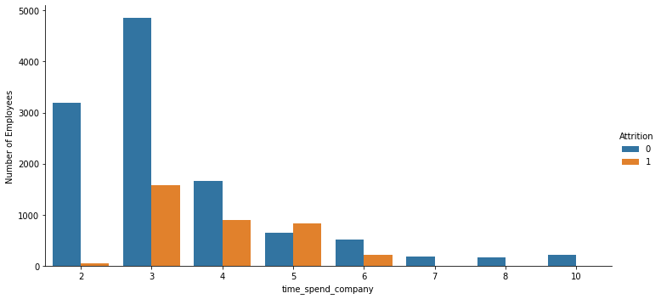
There is no such trend of Attrition in case of Work Accidents.
People who have spent less time with the company tends to leave it earlier as compared to the ones who are here for a longer period of time.
There's no such specific pattern as such, but the employees working highly overtime tend to leave the company.
Same is the case for Satifaction Level, employees less satified with their job end to leave their job earlier.

Slide 25
Building the Predictive Model
Dropping off 'Emp ID' as it is a redundant feature.
The categorical features are not exhibiting much bias-ness, applying K-Fold Target Encoding to map wrt the dependent feature would be a good option.
Some Features seems to be a lightly right skewed.
The Highly Skewed Feature is 'promotion_last_5years' followed by 'Work_accident' and 'time_spend_company'.
Data here excludes the categorical columns.
Skewness for dependent feature isn't to be considered.

Slide 26
During Data Preprocessing -
'salary' feature was been manually assigned weights and encoded.
'dept' feature has been encoded using k-fold target encoding mapping it wrt the dependent variable.
Checking out the correlation amongst the features.
Splitting the dataframe into x and y i.e independent variable vector and dependent variable vector.
Checking for skewness and mending it accordingly. Boxcox will be the best transformation for 'time_spend_company'
Although, 'Work_accident' 'promotion_last_5years' are highly skewed, but we cannot run transformations on them as they're categorical features. as log and sqrt cannot handle '0'

Slide 27
Check for Quasi-Constant Columns.
Standard Scaling all the features to come under a common range.
The Data is Imbalanced. So, we must use ensemble learning methods and cross validation to avoid overfitting.
Now, we split the following dataframes into train and test sets.
For Model Testing, We Deploy 12 different type of ML Model and take out the model having the best performance.
The Accuracy Metrics being used in Model Testing are -
Classification Report
K-Fold Cross Validation Score
Confusion Matrix

Slide 28
The Accuracies of the Models are -
Model Name ----- Accuracy --- f1-score-1 ----- f1-score-0
Logistic Regression : 0.88 0.92 0.73
Random Forest : 0.99 0.99 0.98
Kernel-SVM : 0.97 0.98 0.93
Liner-SVM : 0.88 0.92 0.75
KNN : 0.96 0.97 0.92
Decision Tree : 0.97 0.98 0.94
Naive Bayes : 0.85 0.90 0.72
XGBoost Classifier : 0.98 0.98 0.95
GradientBoosting Classifier : 0.97 0.98 0.94
AdaBoost Classifier : 0.98 0.98 0.95
CatBoost Classifier : 0.96 0.97 0.92
LightGBM : 0.98

Slide 29
So, our Best Model Selected according to its performance is Random Forest !
For Hyperparameter tuning we deploy the techniques of Grid Search and K-Fold Cross Validation.
Dictionary of the Best Parameters after Hyperparameter tuning are -
{'criterion': 'gini',
'max_depth': 8,
'max_features': 'auto',
'n_estimators': 200}

Slide 30
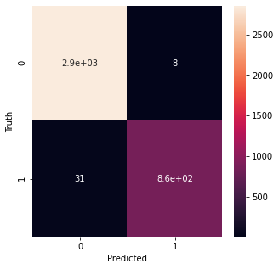
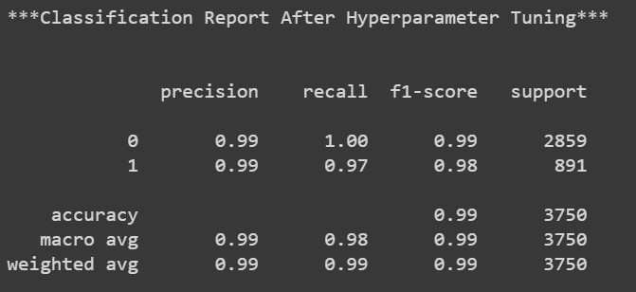
So, there's a slight improvement in our Model After HyperParameter Tuning. Recall has been increased by 0.1% which is great given our dataset was imbalanced.
So, Finally Our Overall Model Accuracy Stands at - 99%
with, 99% Accuracy on '0' Label and
98% Accuracy on '1' Label, which was our Prime Goal.

Slide 31
Then we procede to pickle the model for further use and save the hyperparameters accordingly.
We then create a ML pipeline to automate the process.
And at last, create a requirement file to import the dependencies when required.

Slide 32
Thank You!

